Slide 1
SOFTWARE Architecture

Slide 2

Introduction to Software Architecture & Design

Slide 3
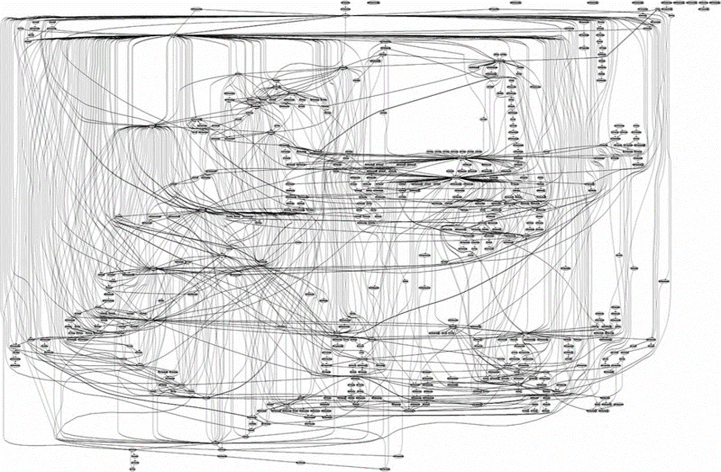
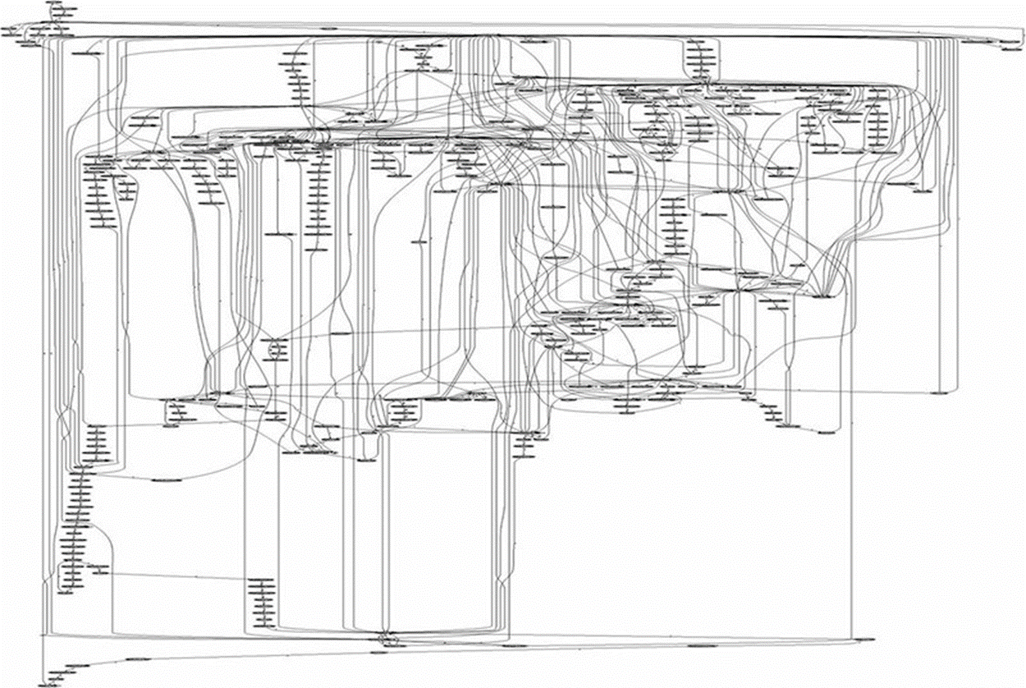
Introduction to Software Architecture
Guess what is this
.. and this
Call graph of Microsoft IIS Webserver
Apache web Server

Slide 4

What is software architecture
Software Architecture is the top level decomposition into major components together with a characterization of how these components interact
Software architecture of a computing system can also be looked at as a big picture depiction of the system
Used for communication among stakeholders
Blueprint for the system and project under development
Negotiations and balancing of functional and quality goals happen during architecture

Slide 5

Why is architecture important
Architecture manifests the earliest set of design decisions
Constraints on implementation
Dictates organizational structure
Inhibits or enable quality attributes and supports WBS
It’s a vehicle for stakeholder communication
Supports reuse at architectural system level like a Product lines or at component level where Systems can be built using large, externally developed elements
Changes to Architecture is Expensive in the later phases of SDLC

Slide 6
Characteristics of software architecture
Addresses variety of stakeholder perspectives
Realizes all of the Use cases and scenarios envisaged for the problem
Supports separation of concerns
Stakeholder concerns using separate architectural views
Quality driven
Closely related to quality attributes like availability, security ..
Recurring styles
Recurring solutions like architectural styles, patterns
Conceptual integrity
It should represent an overall vision of what the system should do separated from its implementation

Slide 7
Factors that influence the software architecture
Functionality
Data Profile
Audience
Usage characteristics
Business Priority
Regulatory and Legal obligations
Architectural standards
Dependencies and Integration
Cost Constraints
Initial State
Architect and the staff background and the skill level
Technical and organizational environment
Technology constraints
Type of user experience planned

Slide 8
Introduction : Design Principles
Detailed design can involve
Further Decomposition (post architecture) of the components being developed if necessary.
Identification and description of the behavior of components/sub-systems
Description of how the interfaces will actually be realized using the appropriate algorithms and data structures
Description on how the system will facilitate interaction with the user through the user interface
Use of appropriate structural and behavioral design patterns
Having Maintenance and reuse as couple of its goals

Slide 9
Techniques which enable design and Issues that need to be handled
Enabling techniques
Abstraction
Focus on essential properties
Modularity, coupling and cohesion
Modularity is the degree to which the larger module can be decomposed
Cohesion is the extern to which modules are dependent on each other. Focused responsibility (Strong)
Coupling indicates how strongly the modules are connected. (Loose)
Information hiding
Need to know
Encapsulation and Separation of interface and Implementation
Limiting complexity
Higher complexity worser design
Inter-modular or intra-modular
Hierarchical structure
Key Issues to be handled in design
Concurrency
Event Handling
Distribution of Components
Non-Functional Requirements
Error, Exception Handling, Fault-Tolerance
Interaction and Presentation
Data Persistence
Notes:
Interaction and Presentation
Interaction and Presentation are techniques that allow the system to react to user input effectively and efficiently
One method is to separates code into three functional areas (Model-View-Controller)
Minimize Coupling and Enhance Cohesion

Slide 10
Differences are in terms of
When each of these happen in the lifecycle, areas of responsibility and the levels of decision making
Architecture is the bigger picture in terms of frameworks, tools, languages, scope, goals and high level methodologies while design is the smaller picture of implementation methodology, with local constraints of how different parts of the system will look, design patterns, programming idioms, refactoring's & how code is organized.
Architecture faces towards strategy, structure and purpose which is at higher level. Design is tactical and faces towards implementation and practice, more towards the concrete.

Slide 11
Software architecture is the structure (or structures) of the system, which comprise of software components, the externally visible properties of those components, and the relationships between them while
Software design is problem-solving & planning for a software solution internal to the system
Architectural decisions are harder to change compared to design decisions which are simpler with lesser impact
Software architecture has more influence on the Non Functional Requirements of the system where the Design has more influence on the functional requirements of the system

